Slide 1
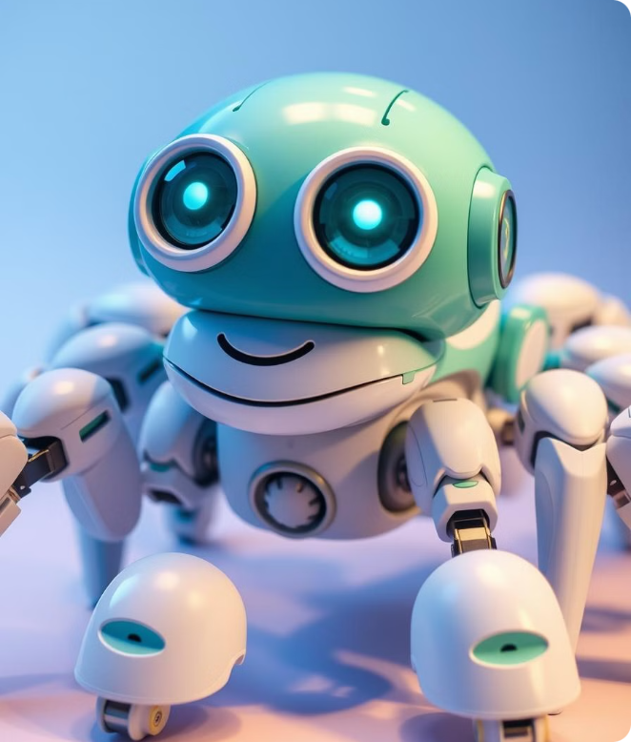
AI: Past, Present and Future
From Turing to today's AI revolution.

Slide 2
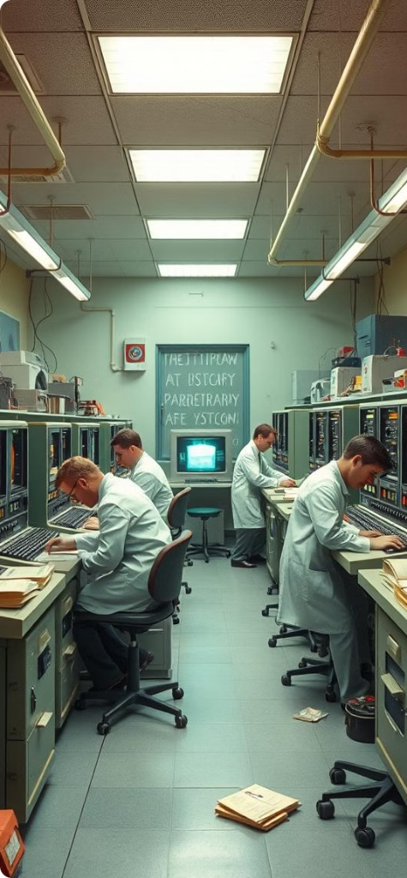
Historical Milestones
1
1950
Turing Test proposed, evaluating machine intelligence.
2
1956
Term "Artificial Intelligence" coined at Dartmouth Conference.
3
1964
ELIZA, first chatbot, created at MIT.
4
1997
Deep Blue defeats chess champion Garry Kasparov.

Slide 3
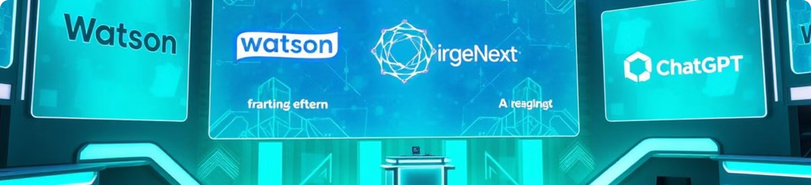
AI Breakthroughs
1
2
3
2011
2012
2022
IBM Watson wins Jeopardy!
Deep Learning revolution begins with ImageNet breakthrough.
ChatGPT released, sparking widespread AI adoption.

Slide 4
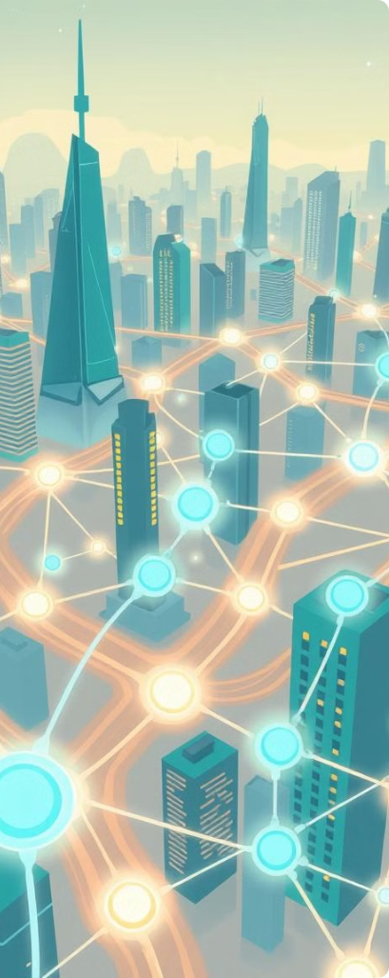




Large Language Models
GPT
OpenAI's powerful language model series.
Claude
Anthropic's AI focused on safety and ethics.
Llama
Meta's open-source contribution to AI research.
PaLM
Google's advanced language model.

Slide 5

Key AI Tools
Tool
Release
Key Features
ChatGPT
Nov 2022
Writing, coding, analysis, creative tasks
Claude 3
2024
Long-form analysis, reasoning, safety focus
Meta AI
2023
Open-source, image generation, assistant
Gamma
2022
AI-powered presentations, automatic slide generation

Slide 6
Real-world Applications
Business
Healthcare
Education
Customer service, data analysis, automation.
Diagnosis assistance, drug discovery.
Personalized learning, automated grading.

Slide 7
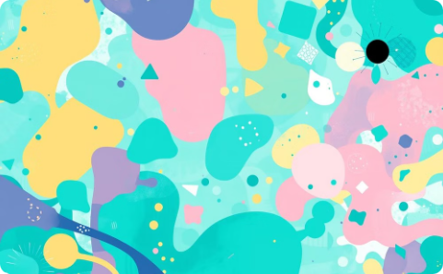
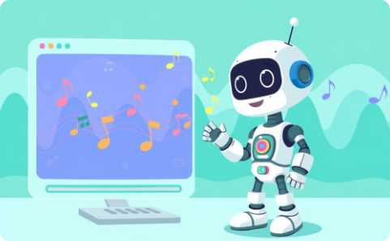
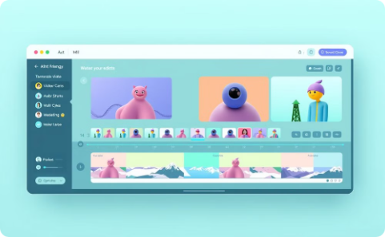
Creative AI
Art Generation
Music Composition
Video Production
AI creating unique visual artworks.
AI assisting in editing and visual effects.
AI composing original melodies and harmonies.

Slide 8
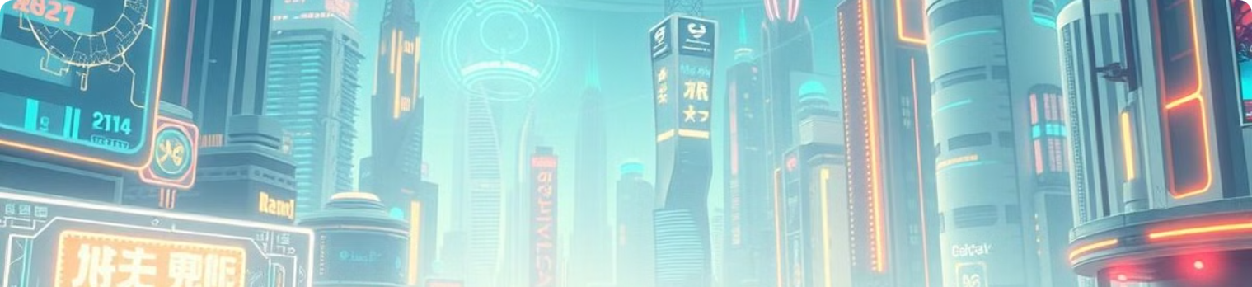
Future Prospects
1
Multimodal AI
2
Enhanced Reasoning
Integrating text, image, video, and audio processing.
AI with improved logical and analytical capabilities.
3
AGI Development
4
Ethical Considerations
Progress towards Artificial General Intelligence.
Responsible AI development and implementation.

